Slide 1

Workload Resiliency
With Microsoft Azure

Slide 2
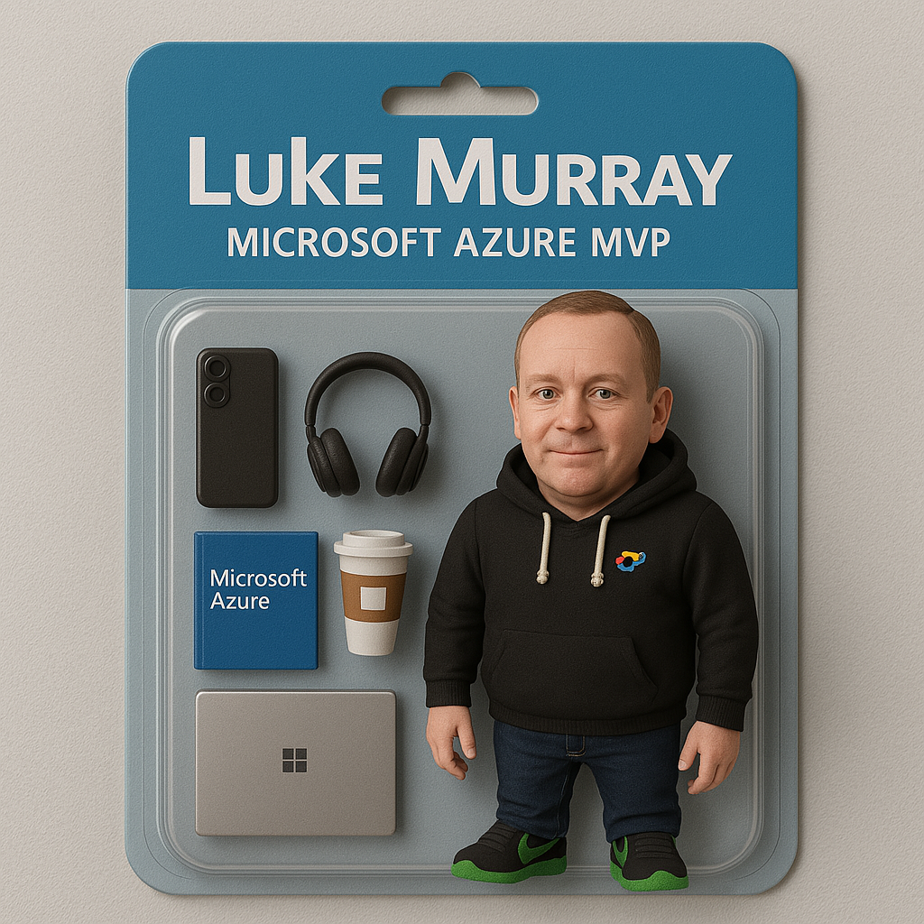

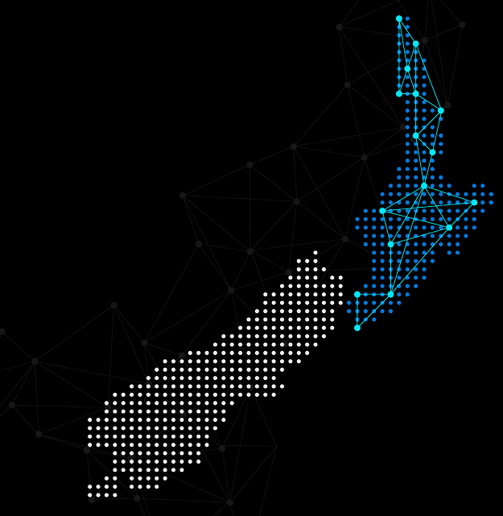

Hello!
Thank you for joining us today
Speaker: Luke Murray
Microsoft Learn Expert and Microsoft Azure MVP, and ISM Service Lead, at HSO from Hamilton, New Zealand.
https://x.com/lukemurraynz
https://www.linkedin.com/in/ljmurray/
https://luke.geek.nz/
https://www.youtube.com/@lukemurraynz

Slide 3

azurebacktoschool.com

Slide 4



Why do bad things happen?
Hardware will fail So we incorporate physical redundancies wherever possible
Software will have bugs
So we deploy code changes cautiously to reduce the impact
People will make mistakes So we automate people out of the equation where it makes sense

Slide 5


Why do bad things happen?
Modified from Reason, 1991
a
Incomplete procedures
Mixed messages
Responsibility shifting
Attention distractions
Coding
bugs
Regulatory narrowness
Production pressures
Inadequate training
Clumsy technology
Deferred maintenance
Accident
Triggers
The World
Institution
Organization
Profession
Team
Individual
Technical
Layers of defense

Slide 6

Microsoft’s responsibility: Reliability ‘of’ the cloud
Network
Region
Availability Zone (AZ)
Datacenter
Cluster
Rack
Node
Microsoft’s infrastructure Microsoft processes Microsoft principles
Virtual machines

Slide 7
Building reliable systems is a shared responsibility
Your application
Your app or workload architecture, built on the below.
Your responsibility Reliability ‘in’ the cloud
Resiliency features
Optional Azure capabilities you enable as needed—high availability, disaster recovery, and backup.
Resilient foundation
Core Azure capabilities built into the platform— how the foundation is designed, operated, and monitored to ensure availability.

Slide 8

Geographies / Regions / Availability Zones (AZs)
Each Azure Geography is comprised of one or more Azure regions that sit within a fixed data residency boundary
In each geography, we have at least one region equipped with Availability Zones
Geography
Region 1
Region 2
Availability Zone 1
Availability Zone 2
Availability Zone 3

Slide 9
Geographies / Regions / Availability Zones (AZs)
Each Azure Geography is comprised of one or more Azure regions that sit within a fixed data residency boundary
In each geography, we have at least one region equipped with Availability Zones
Geography
Region 1
Region 2
Availability Zone 1
Each Azure Region is comprised of one or more datacenters that sit within a fixed metro-level boundary
Usually a single city, within a latency-defined perimeter to enable synchronous data replication
≤1.2ms inter-AZ RTT (<~120km)
Azure serializes platform updates across ‘paired regions’ to ensure that only one region in each pair updates at a time
Availability Zone 2
Availability Zone 3

Slide 10
Geographies / Regions / Availability Zones (AZs)
Each Azure Geography is comprised of one or more Azure regions that sit within a fixed data residency boundary
In each geography, we have at least one region equipped with Availability Zones
Geography
Region 1
Region 2
Availability Zone 1
Each Azure Region is comprised of one or more datacenters that sit within a fixed metro-level boundary
Usually a single city, within a latency-defined perimeter to enable synchronous data replication
≤1.2ms inter-AZ RTT (<~120km)
Azure serializes platform updates across ‘paired regions’ to ensure that only one region in each pair updates at a time
Availability Zone 2
Availability Zone 3
Regions with AZs are comprised of three physically-separated Availability Zones
Each zone is designed to be backed by independent power, cooling, and networking
≤ 0.4ms intra-AZ RTT (<~40km)

Slide 11
Architecting Apps
For Zonal Resiliency

Slide 12
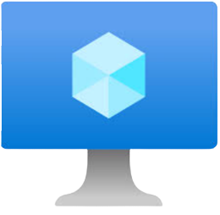
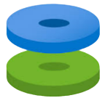





Active-Passive Deployment with ZRS Disks
Zone-redundant storage (ZRS) disks synchronously replicates data across 3 Azure availability zones, ensuring high durability with 99.9999999999% (12 9s) annual availability.
In case of a zone failure, disk remains accessible from another zone, with 0 data loss.
Key Benefits and Usage
Achieve 0 RPO
Use ZRS disks for legacy applications to achieve better availability
RTO of minutes by force detaching the disk and attaching to VM in another zone
Backend pool
East US ; Zone 1
App Gateway frontend IP
HTTP/HTTPS listener
VM1
Zone redundant
data disk 1
Browser
East US ; Zone 2
VM2

Slide 13
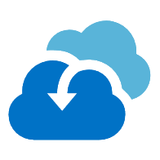
Active-Passive Deployment with Azure Site Recovery enabled
Azure Site Recovery brings disaster recovery (DR) protection for virtual machines (VM) using locally redundant disks in Azure Availability Zones, with zone-to-zone DR.
When a single Azure availability zone is compromised, fail over your VMs to a different zone within the same region and access them from the secondary availability zone.
Key Benefits and Usage
Achieve SLA of 1 hour RTO
Minimal data loss
DR drills using Test Failover
VM1
Locally redundant OS and Data disk 1
Locally redundant OS and Data disk 1 Replica
VM 2
Availability Zone 1
Availability Zone 2
VNet
VNet-asr
Primary - EAST US
Secondary - EAST US

Slide 14


Active-Active Deployment multi-zone Virtual Machine Scale Set
Virtual machine scale set (VMSS) with two or more VM instances deployed across two or more availability zones in same region guarantees uptime of at-least 99.99% (4 9s).
In case of a zone failure, application remains accessible from another zone, with near to no downtime (~0 RTO).
Key Benefits and Usage
0 RTO (downtime) using zone-resilient networking resources for frontend
0 RPO (data loss) with zone-resilient backend data source (Ex: SQL DB)
East US ; Zone 1
Virtual Machine
Disks
Browser
Application Gateway
VM Scale Set
East US ; Zone 2
SQL Database
Virtual Machine
Disks

Slide 15
Start resilient, stay resilient
Design for resiliency
Assess for resiliency
Deploy
How critical is my workload?
Zonal support
by default
Is my workload resilient?
Prioritize
recommendations
Build in automation
Policies to keep you compliant

Slide 16

Cache
Step 1— It starts with a workload
Database
Compute
End user
Compute
Message bus
File
storage
A collection of application resources, data, and supporting infrastructure that function together towards a defined business goal.
Third-party
API
Vault
As defined by the Azure Well-Architected Framework
Governance
Identity provider
Monitoring
Developer/ Ops
Code hosting
Deployment pipelines

Slide 17
Workloads: A real-world customer example
What does a workload look like in the real world? An example of one customer solution, the customer has a “Production Tracking” system which uses app tier and data tier services and depends on shared services within the environment. The customer could group the Azure resources for the workload and its dependencies within these subscriptions:
Production tracking workload
Subscriptions supporting Workload app tier
Subscriptions supporting Workload data tier
Subscriptions supporting Workload shared services
Subscription ID 1
Subscription ID 1
Subscription ID 3
Subscription ID 2
Subscription ID 4
Subscription ID 5

Slide 18
Characteristics of a mission-critical workload
Profitability, reputation, brand, or company mission
Customer security or risk to their clients
Critical infrastructure, including operations
Business health and growth potential
Business Impact
Critical first response services (e.g., EMS)
Societal Impact
Life and safety, human health, etc.
Utilities, water, energy, critical manufacturing, etc.
Human essentials (clean water, medicine, etc.)
Economic stability

Slide 19
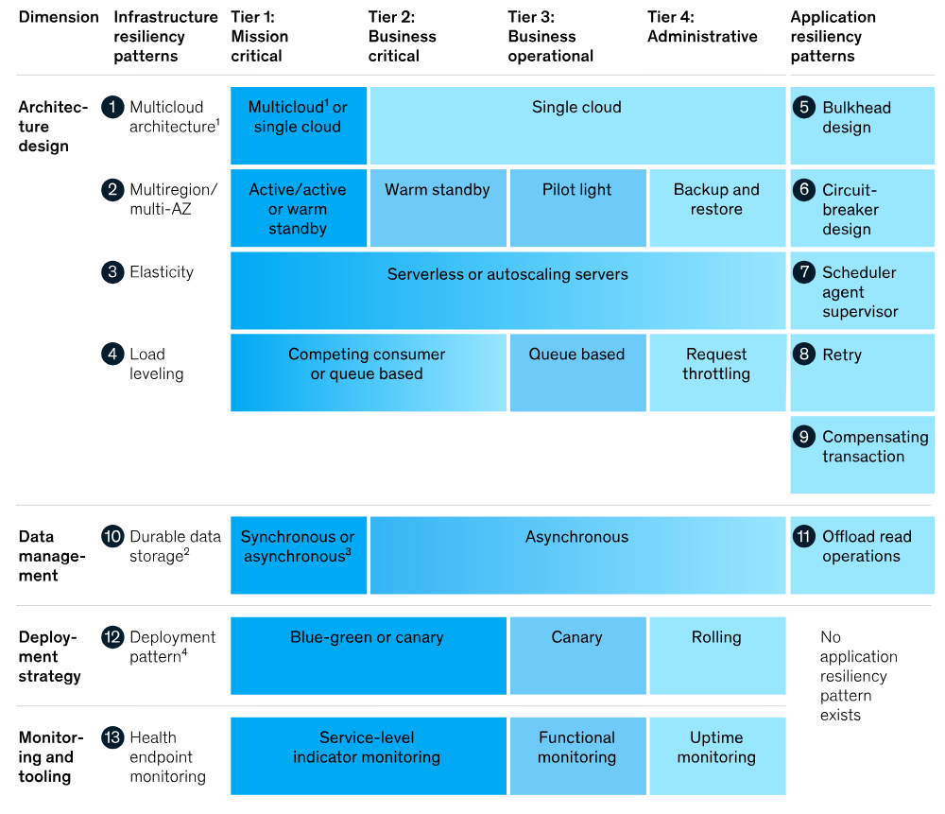

Slide 20
WARA
(Well-Architected Reliability Assessment)

Slide 21
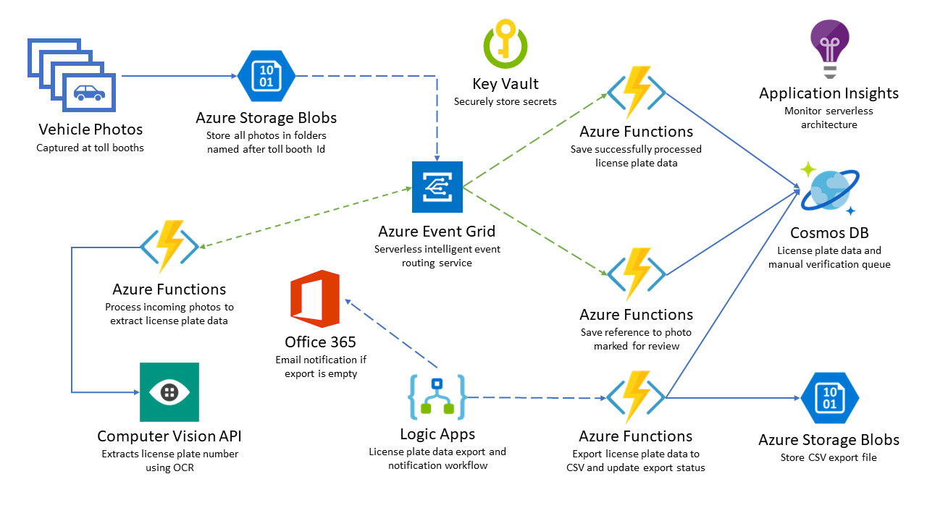
https://github.com/rob-foulkrod/TollBooth

Slide 22
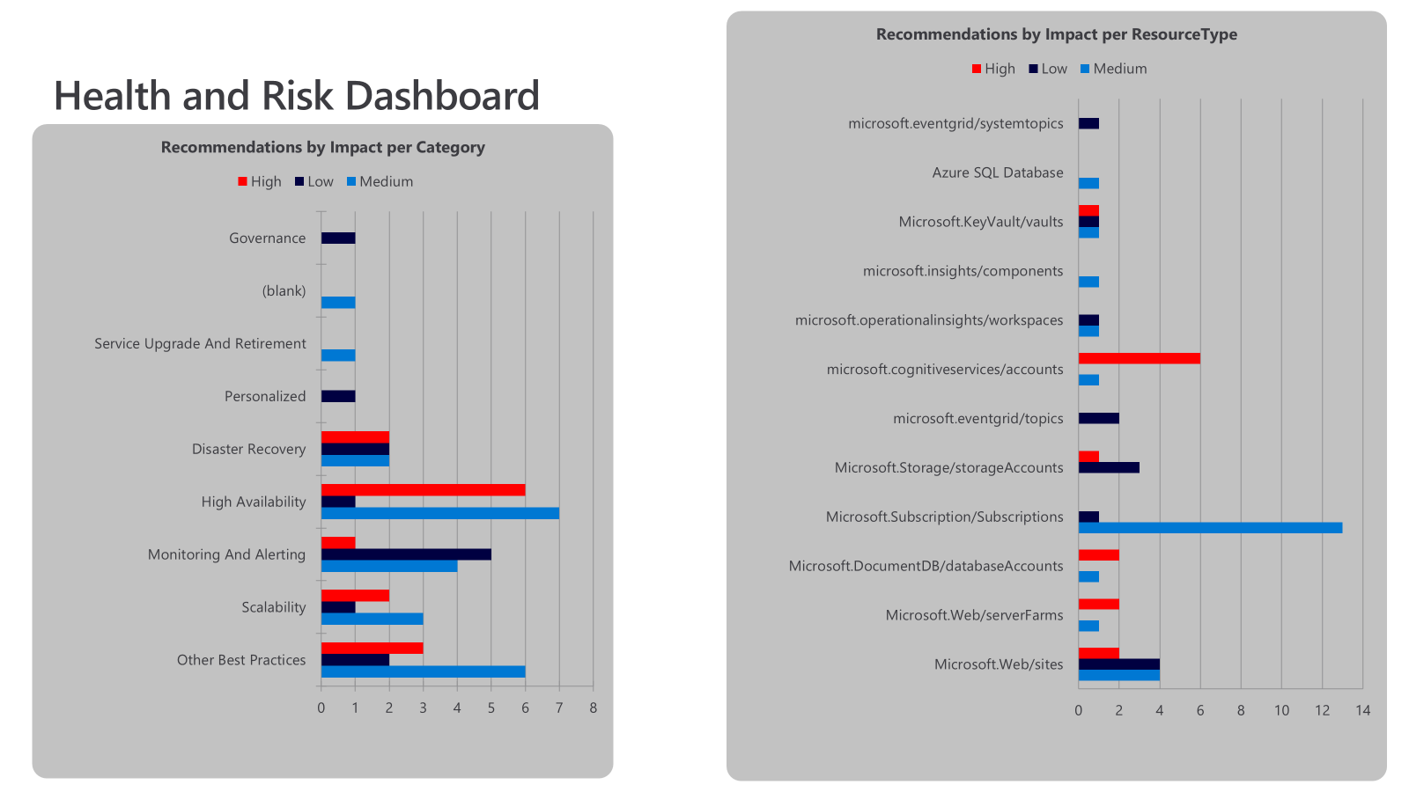
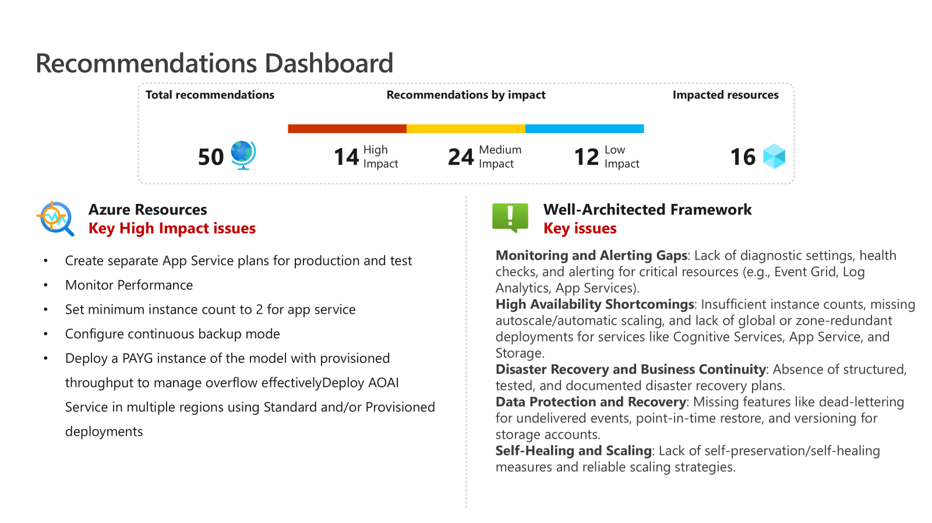

Slide 23
Collect
Analyze
Report
Well-Architected Reliability Assessment script
Install-Module WARA

Slide 25
Thank you!

